Slide 1
🤣
Emojis: More than just a cute face!
Processing and analysis of emojis as natural language in digital content

Slide 2
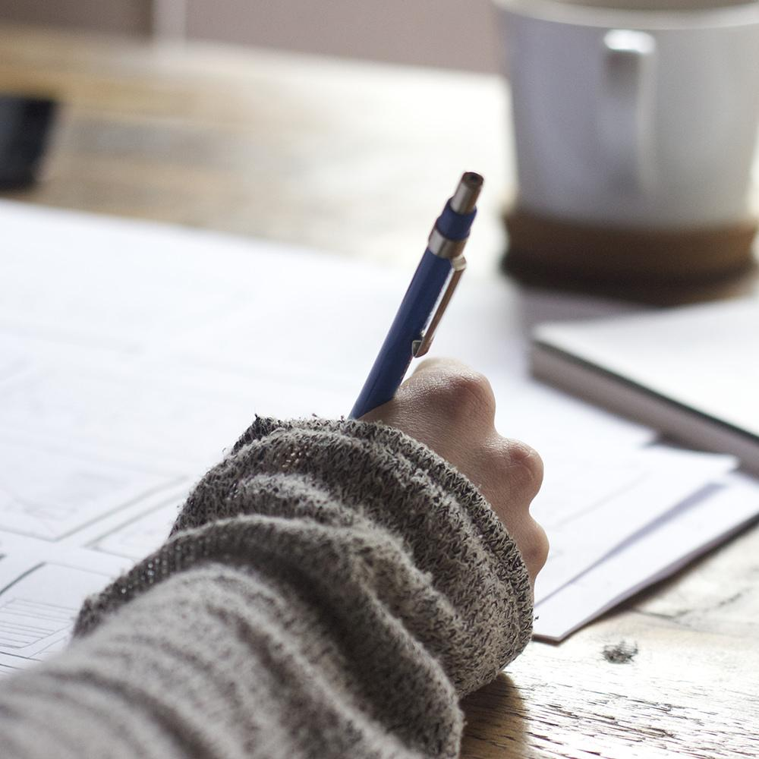
Hello!
👩🏻‍🏫
I am Melanie Swartz, PhD
I am a computational social scientist.
My research focuses on understanding society using computational and data science approaches.
and emoji researcher
^

Slide 3
Today’s lecture
1. Background on emojis
2. Current state of emoji research
3. Resources for processing emojis
4. Exercise in emoji processing
Today’s goal
Appreciate the value of emojis as part of our digital language and know techniques for processing and analyzing them in content
🤩

Slide 4
1.
Background
Let’s start at the beginning

Slide 5
What is an emoji?

Slide 6
What is an emoji?
🤷🏻‍♂️

Slide 7
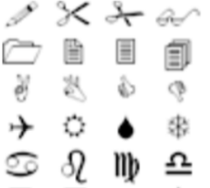

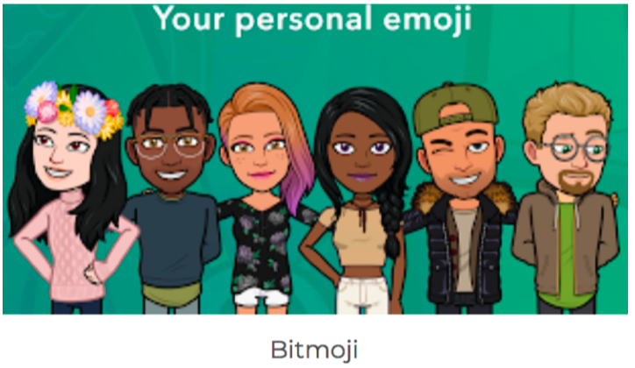
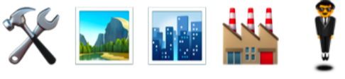
Emoticons
;-)
Wingdings
¯\_(ツ)_/¯
Dingbats
Kaomoji
☺
glyphs
Webdings
stickers

Slide 8
😊
😜
Emoticons
;-)
Wingdings
¯\_(ツ)_/¯
😂
Dingbats
Kaomoji
☺
glyphs
Webdings
stickers

Slide 9
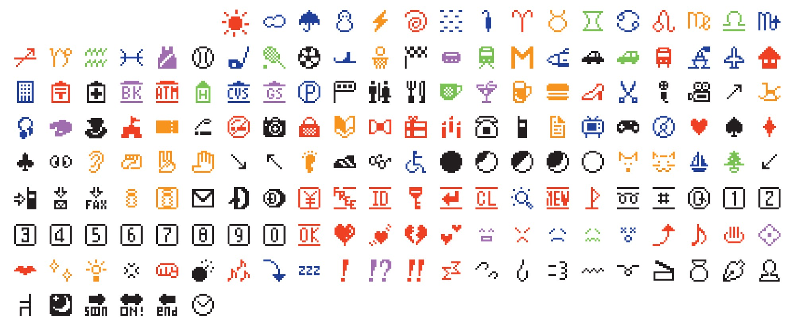
Source: Original emoji from 1999, MOMA.

Slide 10
Where are the smileys?
Source: Original emoji from 1999, MOMA.

Slide 11
Where are the smileys?
Source: Original emoji from 1999, MOMA.

Slide 12

Unicode
Universal
Standards
Interoperability
Approves new emojis

Slide 13
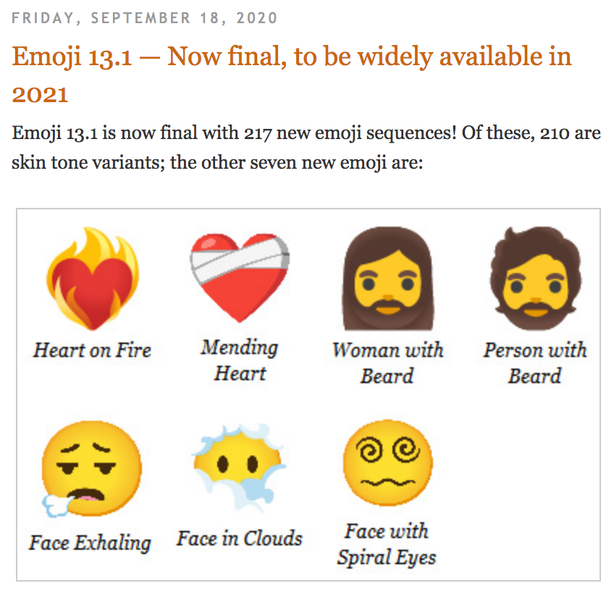
Unicode
Universal
Standards
Interoperability
Approves new emojis
http://blog.unicode.org/2020/09/emoji-131-now-final-to-be-widely.html

Slide 14
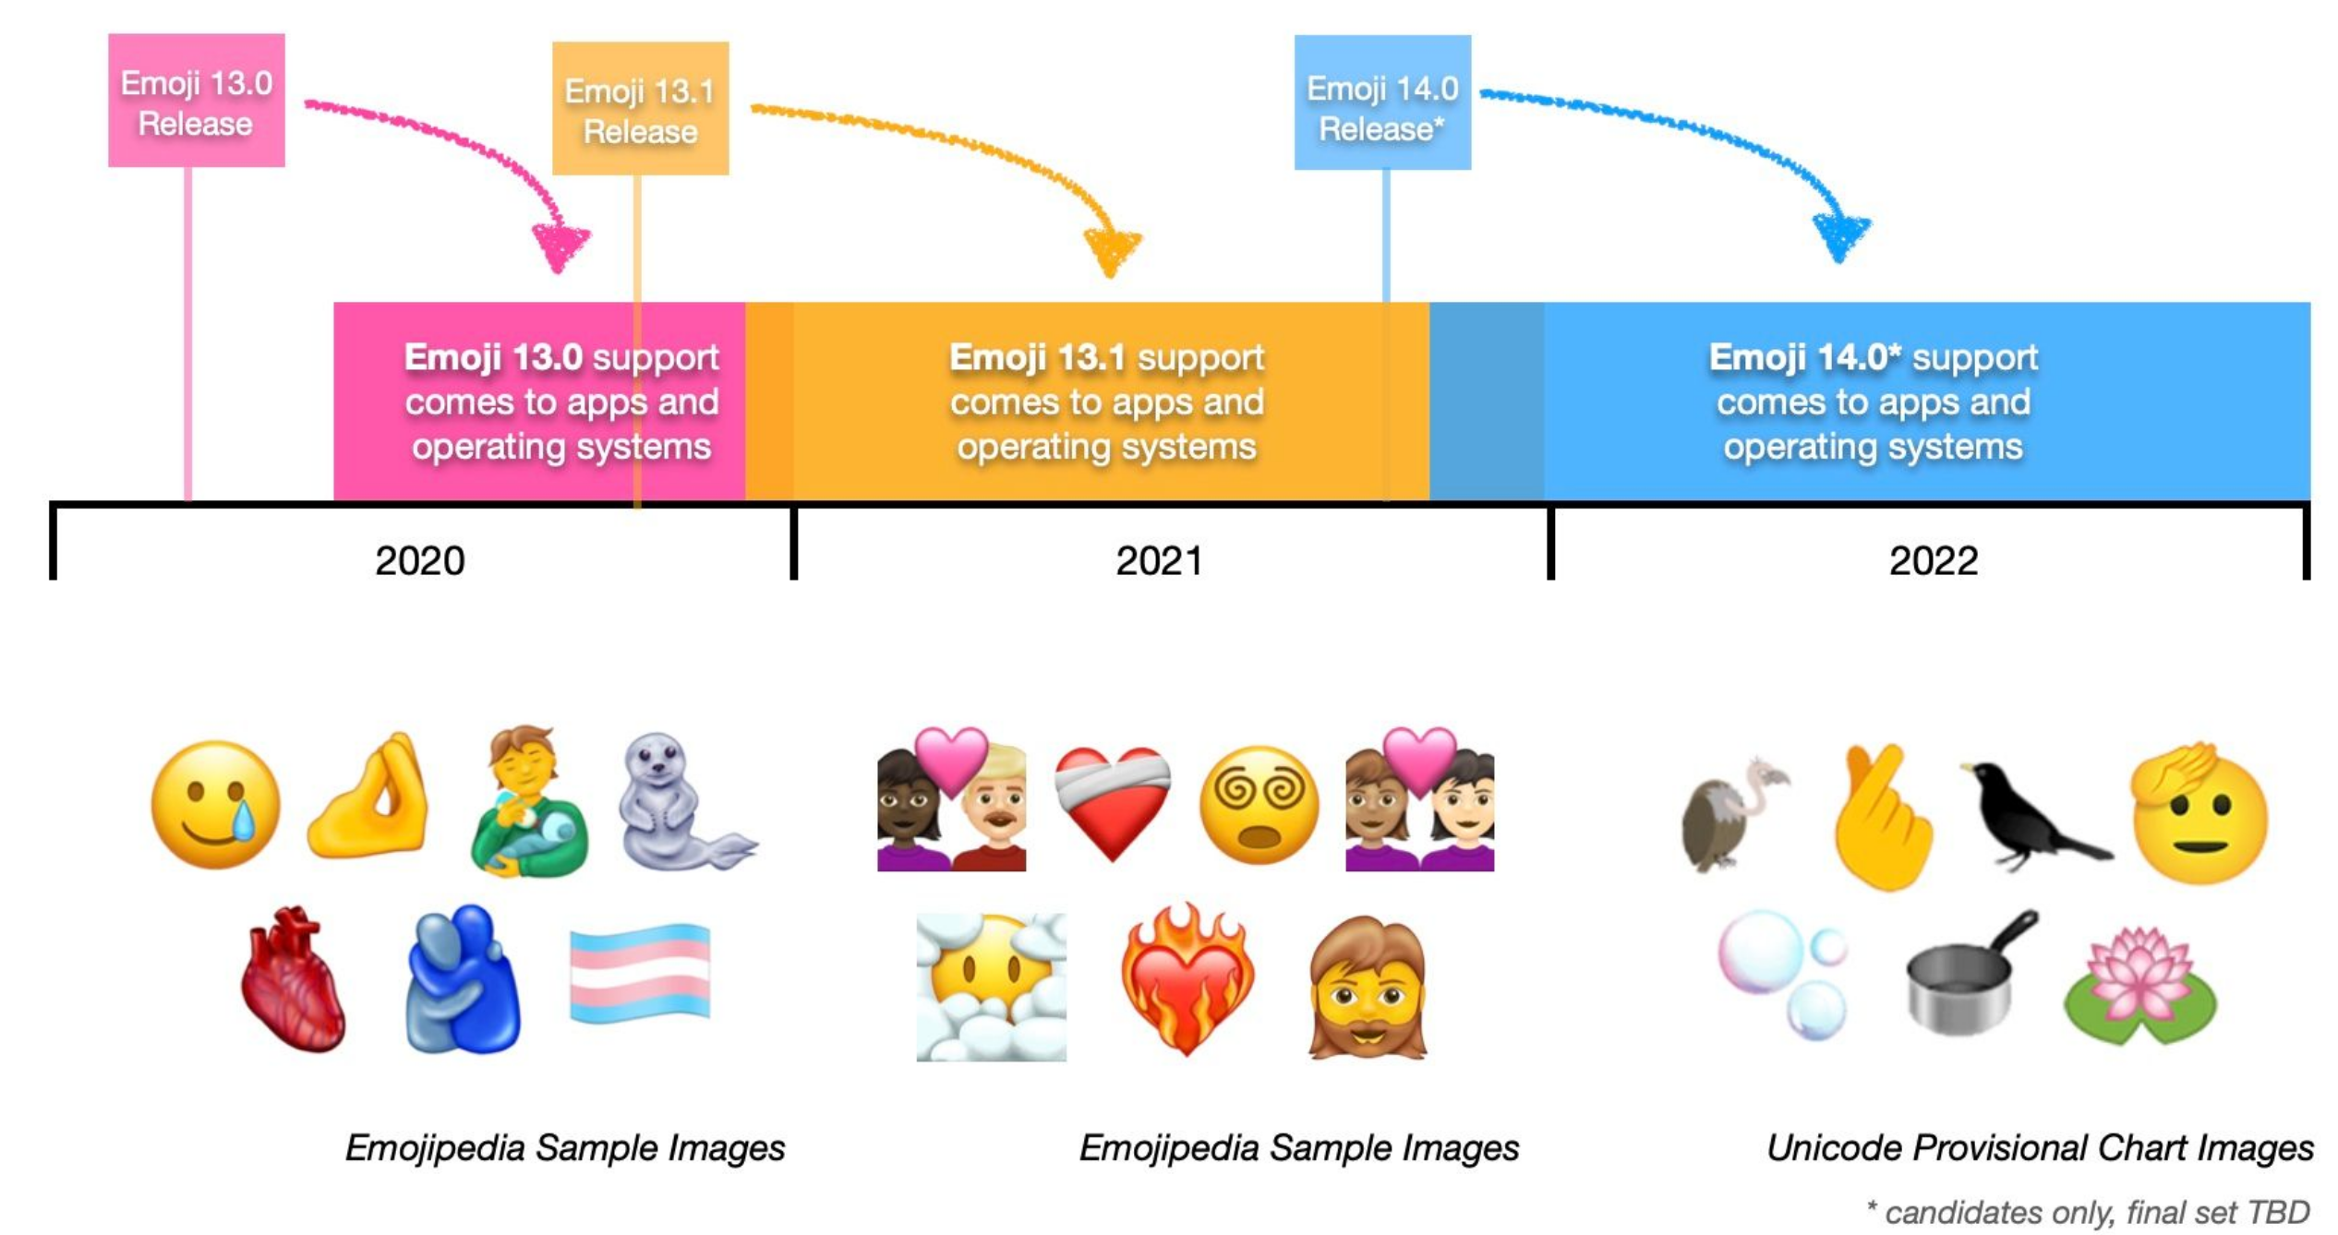
Unicode
Universal
Standards
Interoperability
Approves new emojis
https://blog.emojipedia.org/217-new-emojis-in-final-list-for-2021/

Slide 15
?
“Did you know there are over 3,300 emojis across 9 categories and over 95 sub-categories!”
🤣😝🤯

Slide 16
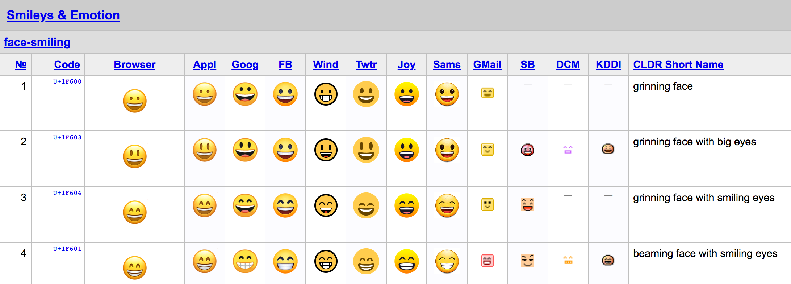
Category (Group)
Sub-category (Subgroup)
https://unicode.org/emoji/charts/full-emoji-list.html

Slide 17
Emoji Categories
Flags
🇦🇶
🌋
Travel and Places
Food and Drink
🍎
🤹‍♀️
Activities
💰
🦓
Objects
Animals
and Nature
🤣
🔶
Smileys and People
Symbols

Slide 18
😋
👨‍👨‍👧‍👦
✌️
👯‍♂️
🤦🏻‍♀️
“Did you know anthropomorphic emojis account for only ~13% of all emojis!”
👵
👩‍🎤
🤣
Smileys and People

Slide 19
Emoji Categories
Let’s Explore!

Slide 20
Emoji Categories
On vacation to ___ we stayed in a ___ to save money, plus the ___ is good there. One day while out ___ , I tripped on ___ and landed on a ___. Everyone’s reaction was ___. Apparently there was a ___ indicating it was dangerous area.
Flags
Travel and Places
🇩🇪
🚲
flag
travel
Food and Drink
🍕
🎭
Activities
food
activity
🪒
🦮
Objects
Animals
and Nature
object
animal
🥶
💯
people
Symbols
Smileys and People
symbol

Slide 21
Emoji-libs
On vacation to ___ we stayed in a ___ to save money, plus the ___ is good there. One day while out ___ , I tripped on ___ and landed on a ___. Everyone’s reaction was ___. Apparently there was a ___ indicating it was dangerous area.
flag
travel
food
activity
object
animal
people
symbol

Slide 22
Emoji-libs
On vacation to ___ we stayed in a ___ to save money, plus the ___ is good there. One day while out ___ , I tripped on ___ and landed on a ___. Everyone’s reaction was ___. Apparently there was a ___ indicating it was dangerous area.
flag
travel
food
activity
object
animal
people
symbol

Slide 23
Emoji-libs
On vacation to ___ we stayed in a ___ to save money, plus the ___ is good there. One day while out ___ , I tripped on ___ and landed on a ___. Everyone’s reaction was ___. Apparently there was a ___ indicating it was dangerous area.
🇦🇶
🌋
flag
travel
🍎
🤹‍♀️
food
activity
💰
🦓
object
animal
🤣
🔶
people
symbol

Slide 24
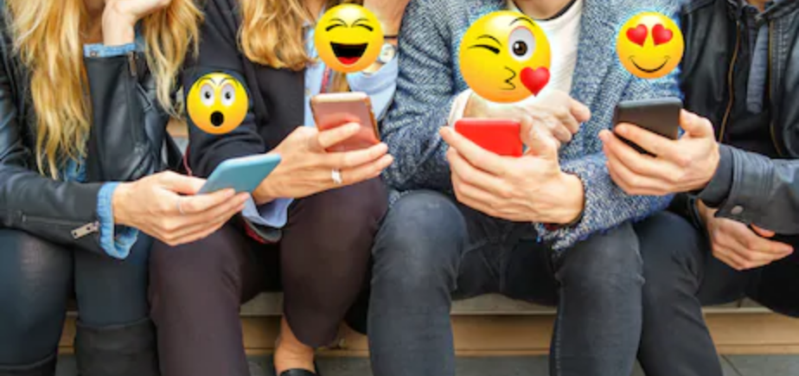
Emojis are part of our digital language
Shutterstock

Slide 25
Emoji use prevalent on mobile devices and used in text messaging and social media. Emojis are sometimes also used in surveys and other media.
Emoji Use on Instagram Over Time
40%
Android Emoji Keyboard
Instagram released for Android
20%
iOS Emoji Keyboard
2010 2011 2012 2013 2014 2015
http://technetworkblog.blogspot.com/2015/05/emoji-new-language-of-internet-is.html

Slide 26
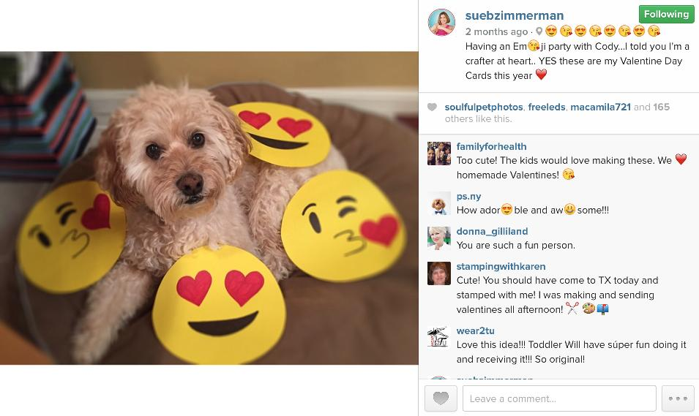
Emojis and Instagram
https://www.postplanner.com/how-to-use-emojis-on-instagram-in-comments/

Slide 27
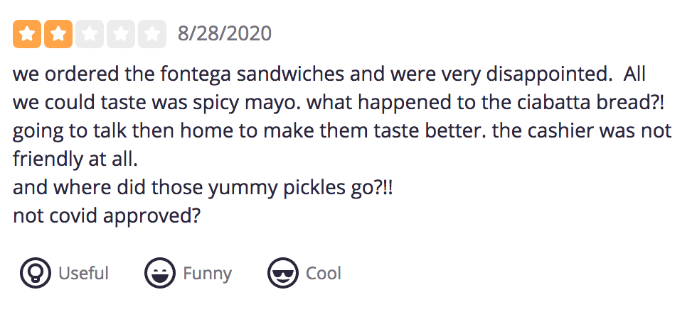
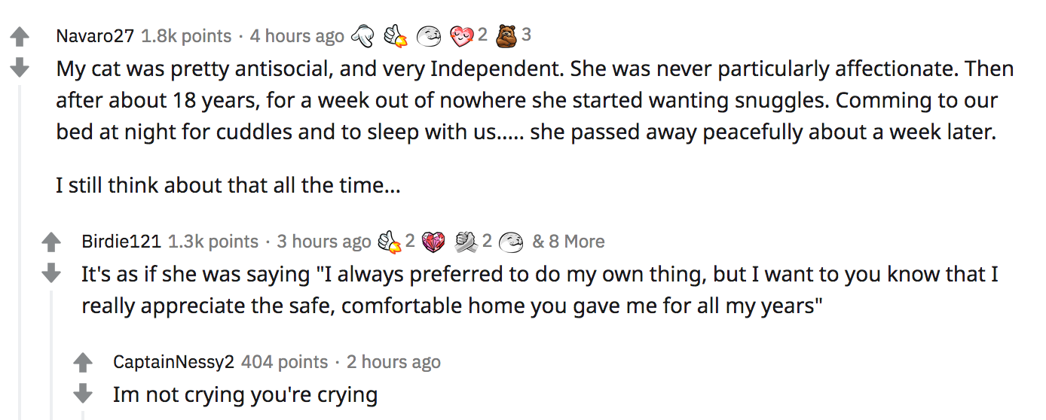
Yelp and Emojis?????
Reddit and Emojis?????

Slide 28

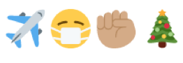
Emojis and Twitter
Some User Profile
Some User’s Name
@username
Profile Description
I am a proud black woman ✊🏽💪🏽 and writer ✍️ who loves to travel. ✈️ 💼

Slide 29
Emojis and Twitter
User’s name can have emoji
Some User Profile
Some User’s Name
@username
Twitter username no emoji
Profile Description
I am a proud black woman ✊🏽💪🏽 and writer ✍️ who loves to travel. ✈️ 💼
User profile with emoji

Slide 30
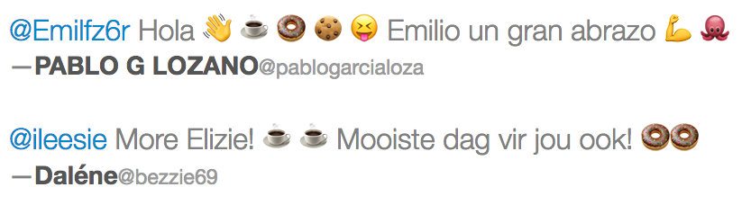
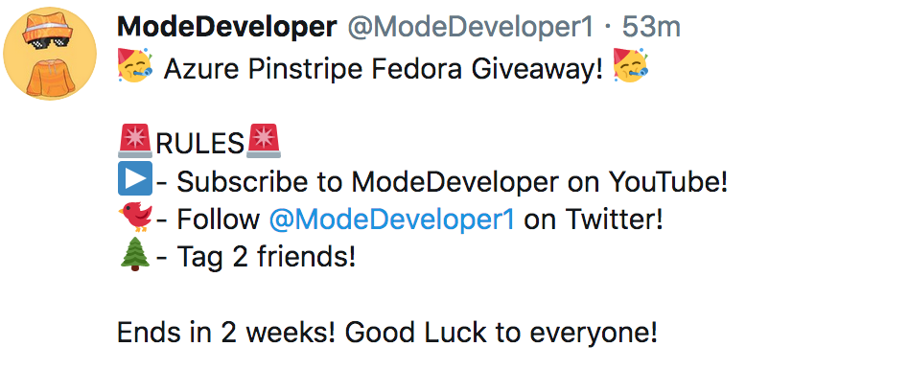
Emojis and Twitter
Tweets

Slide 31
“What is the purpose of emoji in digital communication?”

Slide 32
User role
“What is the purpose of emoji in digital communication?”
👨🏻‍🌾🤖😻

Slide 33
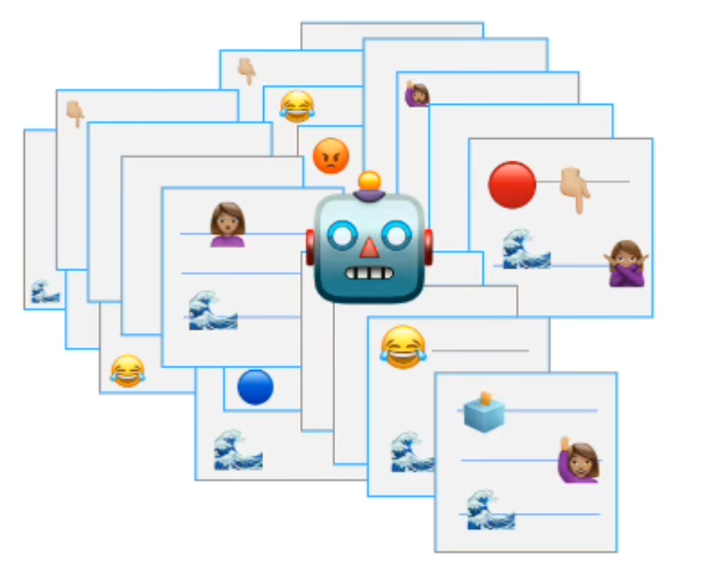
User role

Slide 34
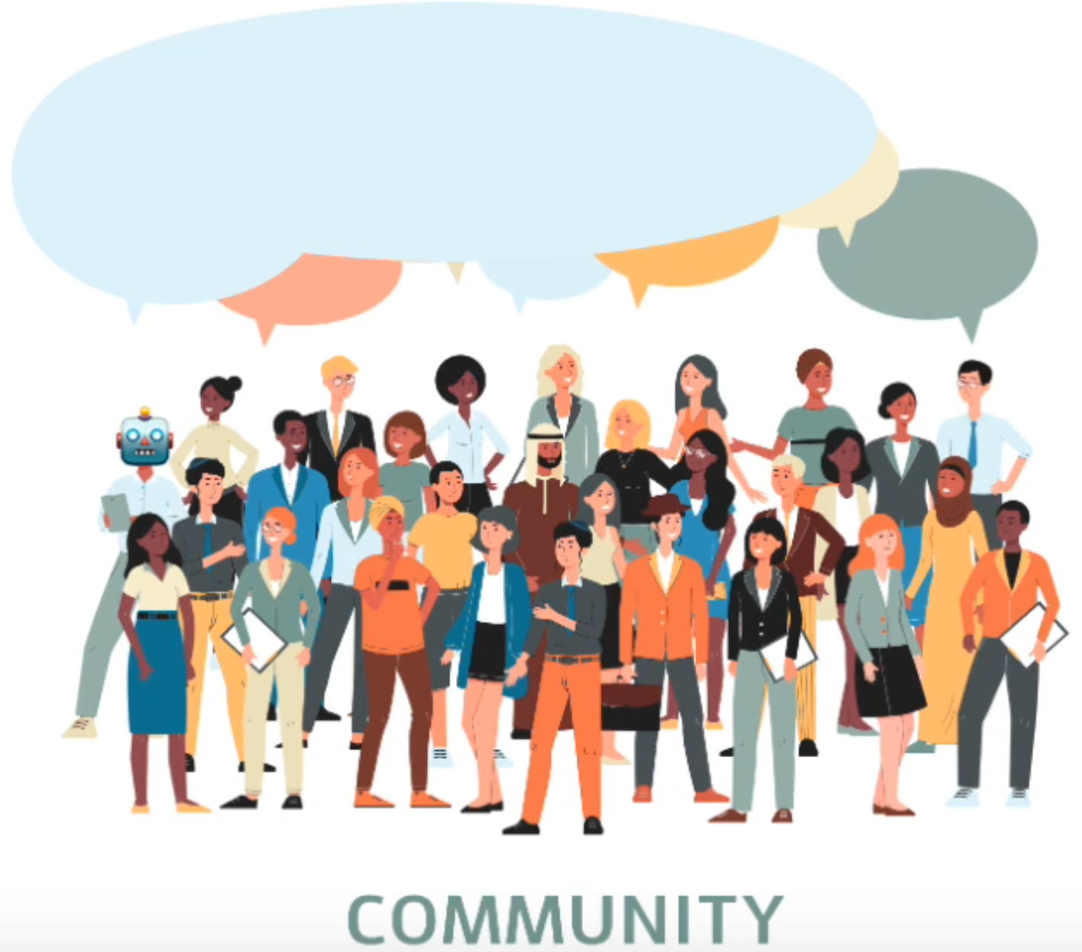
User role
Swartz, M., Crooks, A., and Kennedy, W. G.. (2020). Diversity from Emojis and Keywords in Social Media. In International Conference on Social Media and Society (SMSociety ’20), July 22–24, 2020, Toronto, ON, Canada. ACM, New York, NY, USA, 9 pages. https://doi.org/10.1145/3400806.3400818

Slide 35
User role
“What is the purpose of emoji in digital communication?”
Document
🗺📖📝

Slide 36
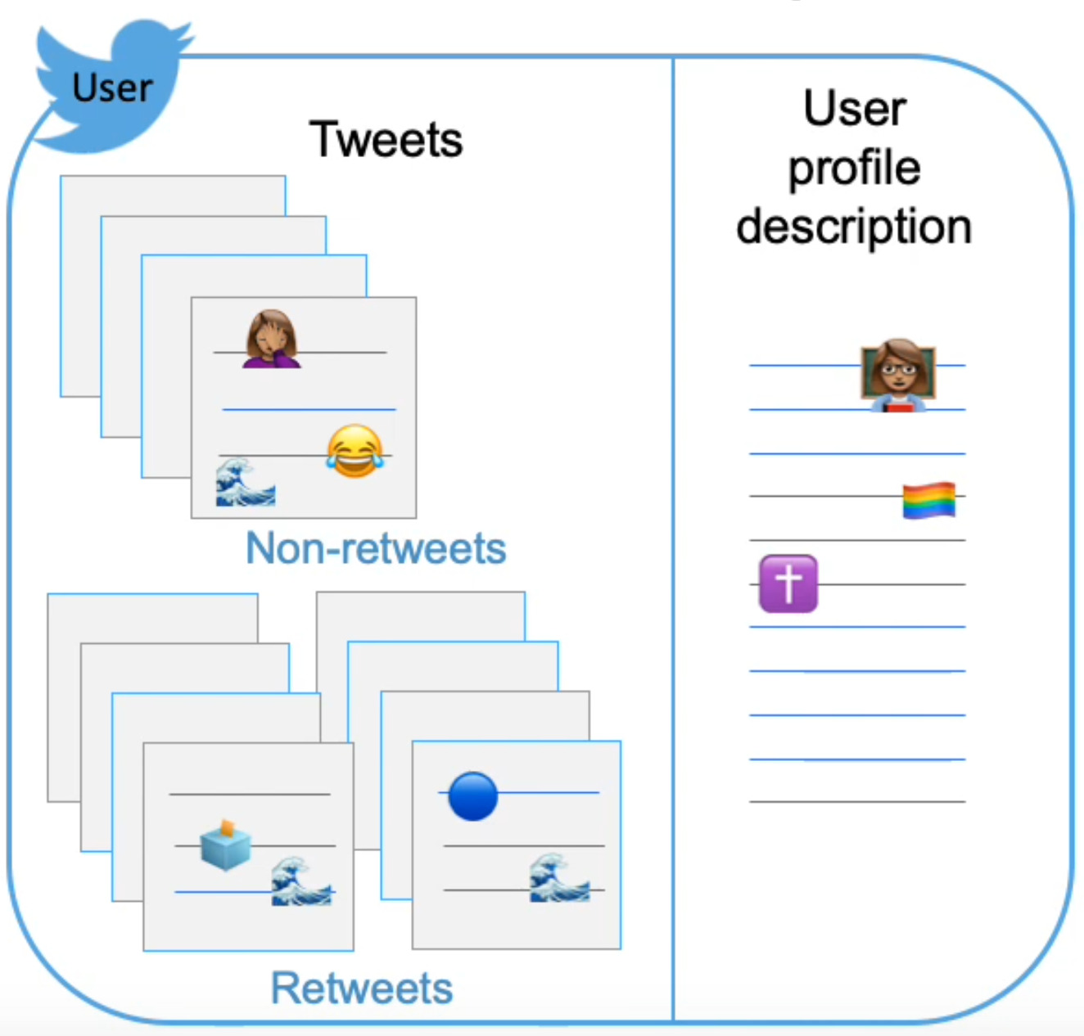
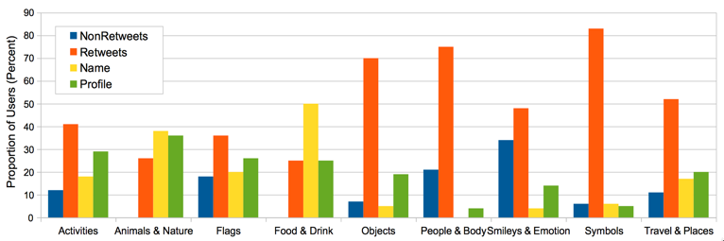
Profile
description
Retweets
Non-retweets
User Name 🤖💕
Source: M. Swartz and A. Crooks, "Comparison of Emoji Use in Names, Profiles, and Tweets," 2020 IEEE 14th International Conference on Semantic Computing (ICSC), San Diego, CA, USA, 2020, pp. 375-380, doi: 10.1109/ICSC.2020.00075.

Slide 37
User role
“What is the purpose of emoji in digital communication?”
Document
Patterns

Slide 38
Emojis in tweets

Slide 39
Communicative?

Slide 40
Repetition
Repetition

Slide 41
Repetition
Magnitude/Amplification?

Slide 42
Decoration?
Attention seeking?

Slide 43
More on Patterns of Emoji Use …
… to be presented at SBP-BRiMS October 18-20, 2020
Swartz, M., Crooks, A.T. and Croitoru, A. Beyond Words: Comparing Structure, Emoji Use, and Consistency Across Social Media Posts, 2020 International Conference on Social Computing, Behavioral-Cultural Modeling and Prediction and Behavior Representation in Modeling and Simulation, Washington DC.

Slide 44
2.
Current state of emoji research
Foundation and State of the Art

Slide 45
Before we continue…

Slide 46
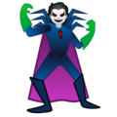









Pick a character …

Slide 47
They are all the same!
UTF-8 Codepoint
U+1F9B9
: supervillain :

Slide 48
Rendering varies by device…
Apple
Google
Microsoft
Samsung
WhatsApp
Twitter
Facebook
JoyPixels
OpenMoji
Emojipedia

Slide 49
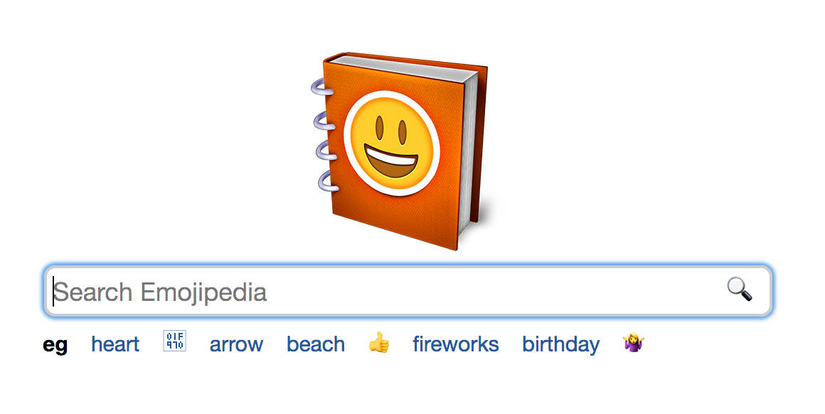
Emojipedia
https://emojipedia.org/

Slide 50
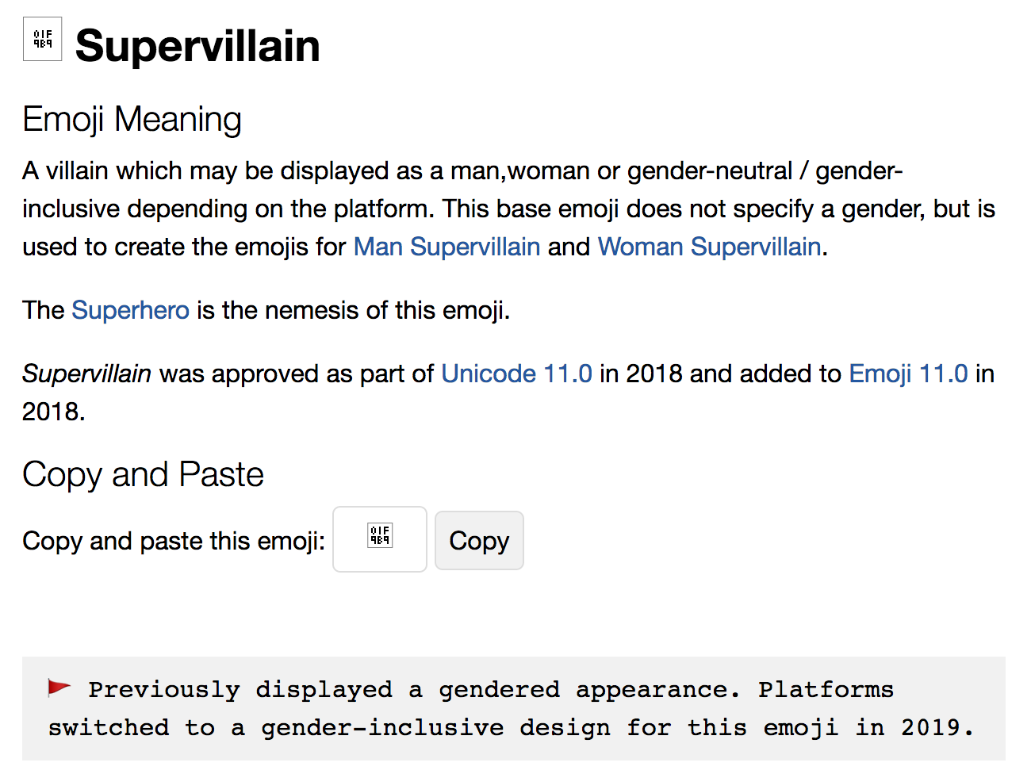
Emojipedia
https://emojipedia.org/supervillain/

Slide 51
Emoji research main areas
emotion and tone
differences in use
disambiguation

Slide 52
Disambiguation
Differences in emoji meaning
Rendering
Interpretation
Sender/Receiver Context

Slide 53
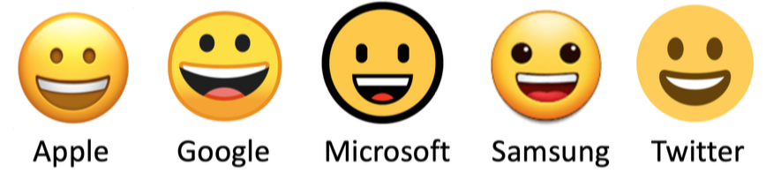
Disambiguation
Rendering by device
Impacts user choice
Changes meaning
Differences in emoji meaning
Rendering
Interpretation
Sender/Receiver Context
(Lu et al., 2016; Tigwell & Flatla, 2016)
(Miller et al., 2016)

Slide 54
Differences in interpretation
One emoji may have many meanings
Meaning impacted by use, context, social norms, culture
Way the emoji is used e.g. emoji as icon, index, symbol
Influence of nearby text
🍑
(Barbieri et al., 2016; Donato & Paggio, 2017; Swartz & Crooks, 2020; Tigwell & Flatla, 2016)
(Ai et al., 2017; Miller et al., 2017; Riordan, 2017; Swartz & Crooks, 2020)

Slide 55
Differences in interpretation
One emoji may have many meanings
Meaning impacted by use, context, social norms, culture
Way the emoji is used e.g. emoji as icon, index, symbol
Influence of nearby text
🍑
(Barbieri et al., 2016; Donato & Paggio, 2017; Swartz & Crooks, 2020; Tigwell & Flatla, 2016)
(Ai et al., 2017; Miller et al., 2017; Riordan, 2017; Swartz & Crooks, 2020)
🚒 🚑 👀
Tweet with red siren
🚨

Slide 56
Differences in use
Gender, Age, Appearance
Personality
Country
User/Group/Role

Slide 57
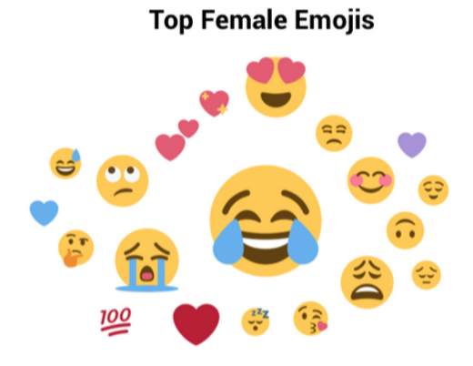
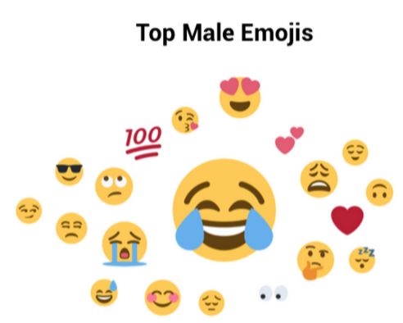
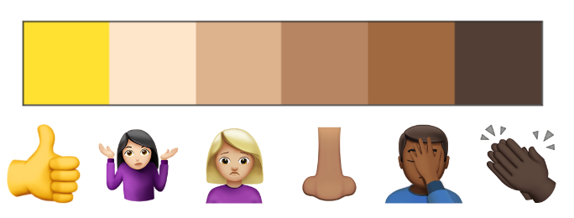
Differences in use
Li et al., 2018; Marengo et al., 2017
Gender, Age, Appearance
Personality
Country
User/Group/Role
(Chen et al 2018; Herring & Dainas, 2018)
(Robertson et al 2020)
O.C.E.A.N.
(Li et al., 2018; Marengo et al., 2017)

Slide 58
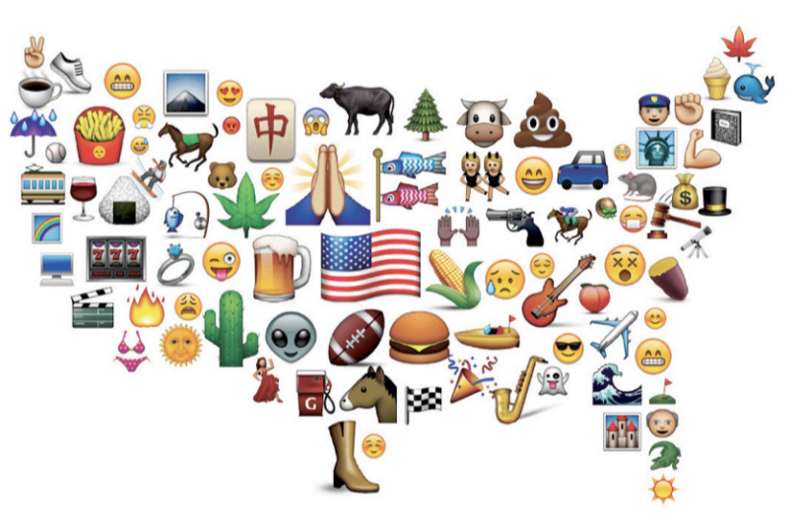
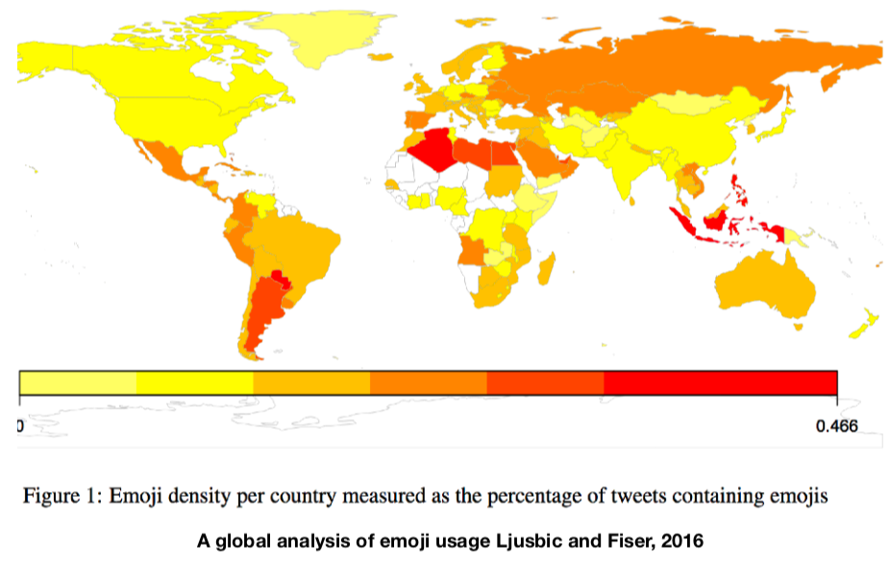
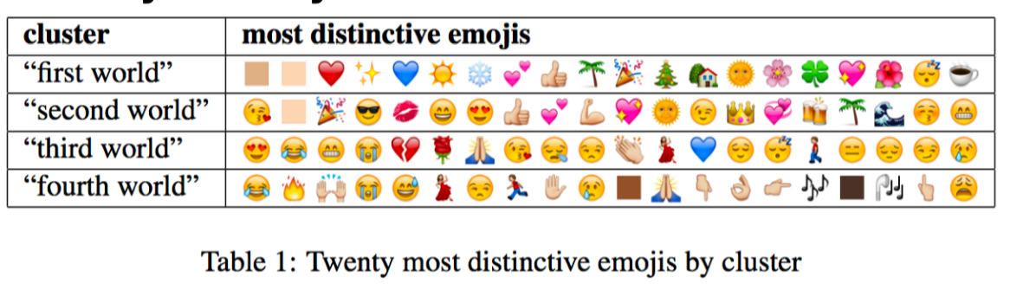
Emoji use by country/region
Brandon Sudol (https://brendansudol.com/emoji-usa/viz/top4/)
Emoji use by country (density of emojis used in tweets)
Ljusbic and Fiser, 2016

Slide 59
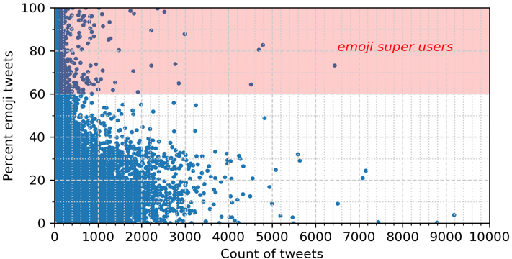
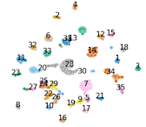
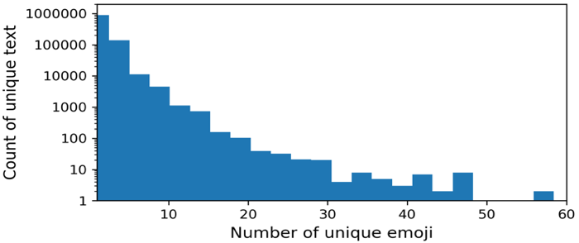
Emoji use by user/group/role
Emoji super users
Consistent in emojis used
Similarities in which emojis are used and way they are used based on user group/role
(Swartz and Crooks, 2020; Swartz, Crooks, Croitoru, 2020)
Clusters of users based on emoji use patterns
Swartz, Crooks, Croitoru, 2020
Swartz and Crooks, 2020.

Slide 60
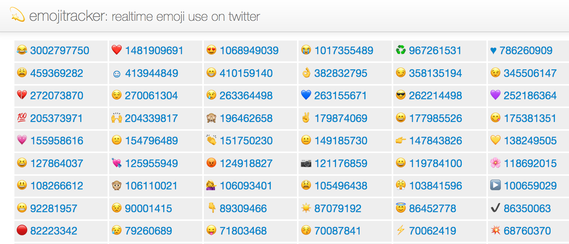
Source: https://emojitracker.com/

Slide 61
Emotion and Tone
Emojis as cues for digital face/body gestures to indicate emotion and tone.
Sentiment
Sarcasm
Emotion
Structural markers
Did you see that? 🤣 🤣
I ❤️ studying for exams! 😫😢😰
Let’s eat! 🍕😋
Any questions? 🙋‍♀️
(Chen et al., 2019; Felbo et al., 2017; Kimura & Katsurai, 2017; Kralj Novak et al., 2015; Gawne & McCulloch, 2019; Spina 2019)

Slide 62
3.
Resources for Processing Emoji in Text
Python and other resources

Slide 63
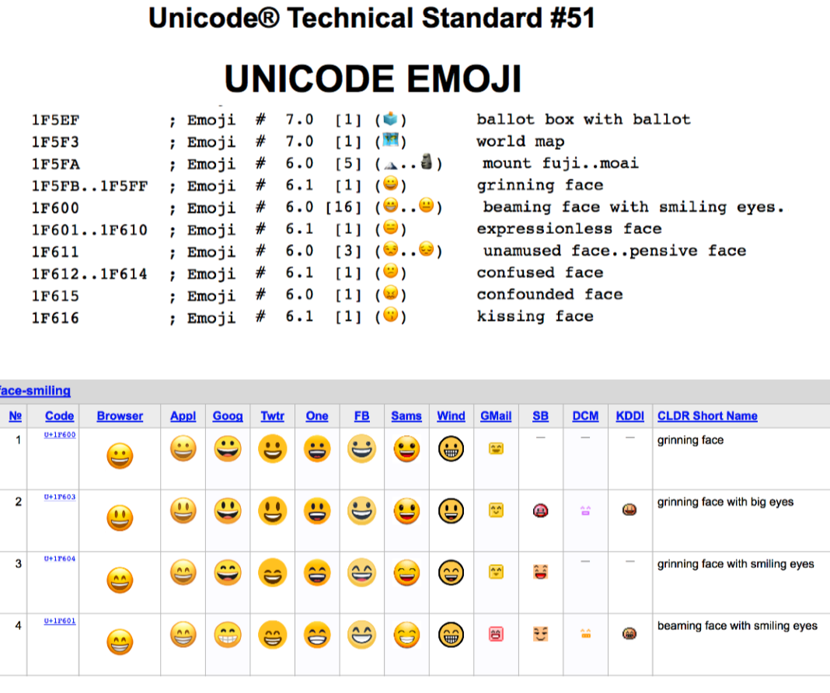
Resources
Unicode
Emojipedia
Github
https://unicode.org/Public/emoji/13.1/emoji-test.txt
https://unicode.org/emoji/charts/full-emoji-list.html

Slide 64
Resources
Unicode
Emojipedia
Github

Slide 65
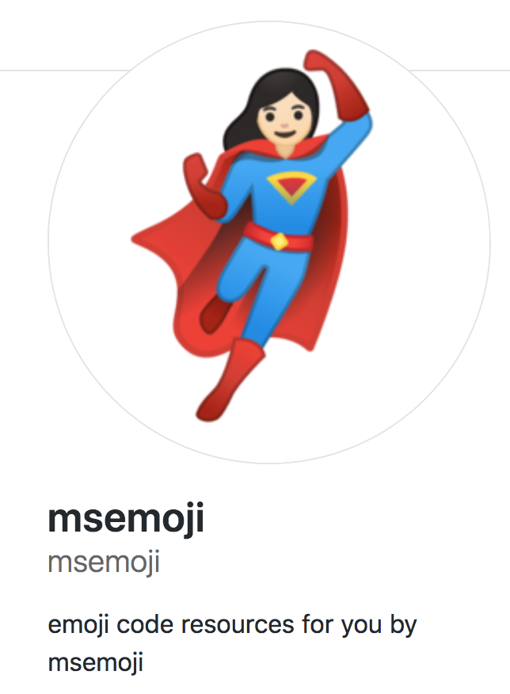

Resources
Unicode
Emojipedia
Github
Python
https://github.com/msemoji/

Slide 66
Beware…. no perfect emoji code base
- Many Python packages, some good/bad, fast/slow
- Support for newest emojis often lacking
- Are flags, symbols, and compound emojis supported
- Qualified emojis? Fully-, partially-,not-
- Firefox/Jupyter notebook

Slide 67
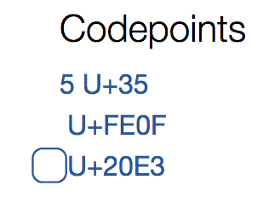
Flags: 2 codepoints
🇺🇸 = 🇺 🇸
Keycaps and others:
Emoji style indicator
5️⃣ = 5️ ⃣
Emoji variation selector / emoji style indicator
(invisible codepoint U+FE0F)

Slide 68
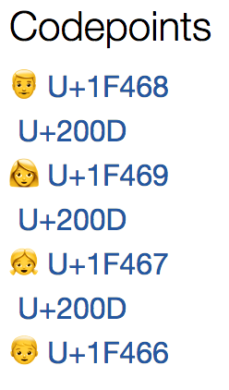
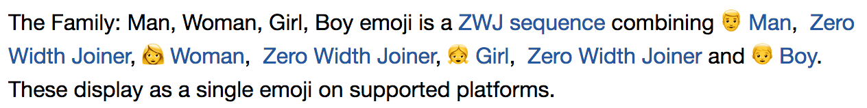
Compound emojis
👨‍👩‍👧‍👦 = 👨 ‍👩 ‍👧‍ 👦
Zero width joiner (zwj)
(invisible codepoint u200D)

Slide 69
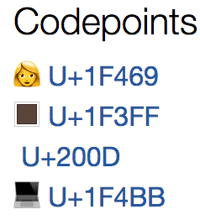

Emoji modifiers
👩🏿‍💻 = 👩 🏿‍ 💻
Modifier
(e.g. skintone, gender)

Slide 70
4.
Emoji Processing
Python using msemoji

Slide 71
Common ways to deal with emojis
Ignore them
Change them into the word name
Process them separately
Assign a value (e.g. sentiment)

Slide 72
Common ways to deal with emojis
I ❤️ YOU
Ignore them
Change them into the word name
Process them separately
Assign a value (e.g. sentiment)

Slide 73
Common ways to deal with emojis
I ❤️ YOU
I YOU
Ignore them
Change them into the word name
Process them separately
Assign a value (e.g. sentiment)

Slide 74
Common ways to deal with emojis
I ❤️ YOU
Ignore them
Change them into the word name
Process them separately
Assign a value (e.g. sentiment)
I [Heavy Black Heart] YOU

Slide 75
Common ways to deal with emojis
I ❤️ YOU
Ignore them
Change them into the word name
Process them separately
Assign a value (sentiment)
I ❤️ YOU
❤️

Slide 76
Common ways to deal with emojis
I ❤️ YOU
Ignore them
Change them into the word name
Process them separately
Assign a value (sentiment)
I ❤️ YOU
(positive)

Slide 77
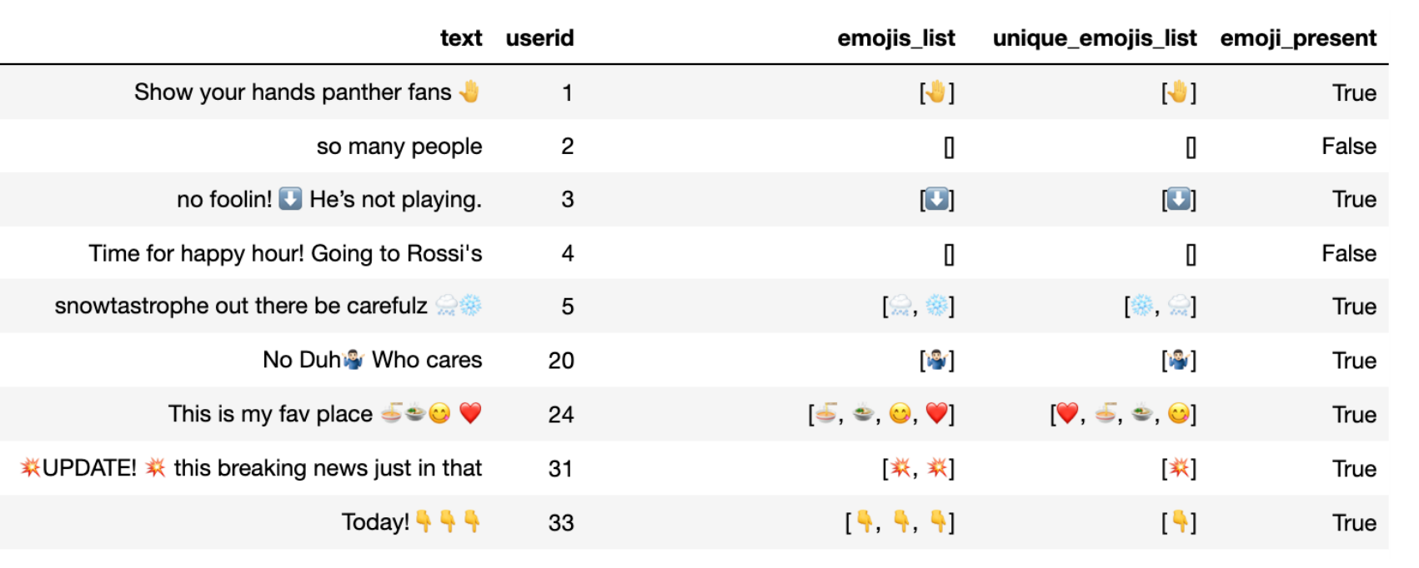
Text processing to extract emojis

Slide 78
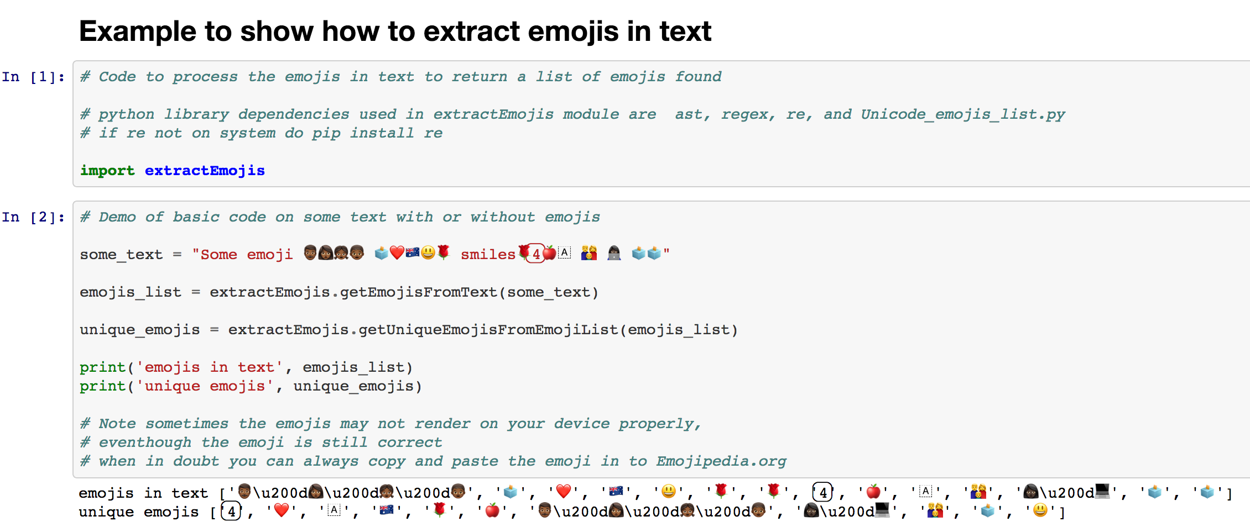
Text processing to extract emojis
https://github.com/msemoji/
https://github.com/msemoji/emoji_extract/blob/master/Demo_Extract_Emojis_from_Text.ipynb

Slide 79
🤣
Emojis: More than just a cute face!
Processing and analysis of emojis as natural language in digital content

Slide 80
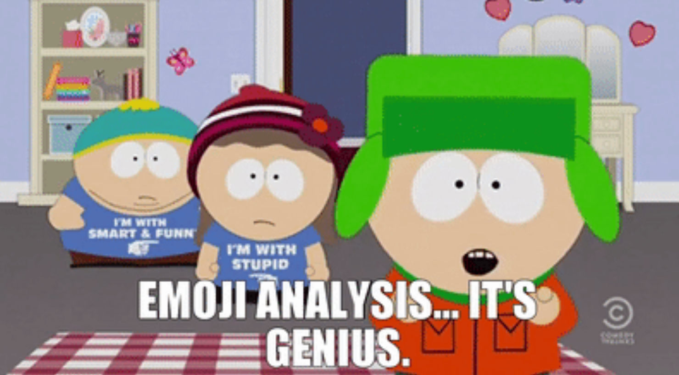
Source: Clip from South Park episode S20e06, Comedy Central.

Slide 81
THANKS!
Any questions?
❓
😺

